Slide 1
Review of Feedback Control System

Slide 2
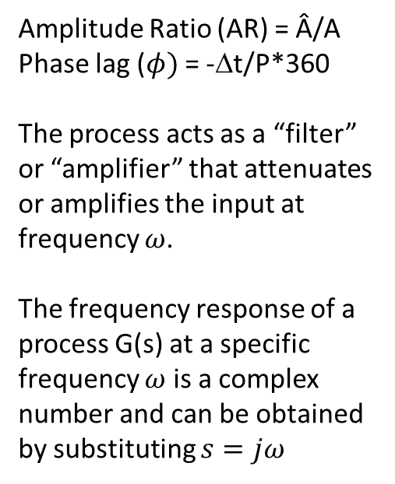
Frequency Response
$$u=A sinωt$$
$$y=\hat{A }sin⁡(ωt+φ)$$
Process
Amplitude Ratio (AR) = Â/A
Phase lag ($φ)$ = -Δt/P*360
The process acts as a “filter” or “amplifier” that attenuates or amplifies the input at frequency $ω$.
The frequency response of a process G(s) at a specific frequency $ω$ is a complex number and can be obtained by substituting $s=jω$
P
Δt

Slide 3
Frequency Response
$G\left(jω\right)=Re\left(ω\right)+j Im\left(ω\right)=ρ\left(ω\right)e^{jφ(ω)}$
$ρ\left(ω\right)=AR=\sqrt{Re^{2}\left(ω\right)+Im^{2}(ω)}=\left|G(jω)\right|$
$φ=phase difference=arc\tan\left(\frac{Im\left(ω\right)}{Re\left(ω\right)}\right)=∠G(jω)$
Two ways of representing the frequency response
Bode Plot
Log-Log plot of AR vs $ω$ and semi-log plot $φ$ vs $ω$
Nyquist Plot
Plot of Re($ω$) vs Im($ω$) for various values of $ω$.
Frequency does not appear explicitly in this plot.

Slide 4
Bode Plot
Steady state gain:
$$K=ρ\left(0\right)e^{jφ(0)}$$
Bandwidth, $ω_{b}$, defines the highest frequency at which the process displays no attenuation. It is calculated based on the frequency when amplitude reaches 0.707 K.
Roll-off is slope of decaying AR at high frequencies.
Meeting pt of LFA and HFA

Slide 5
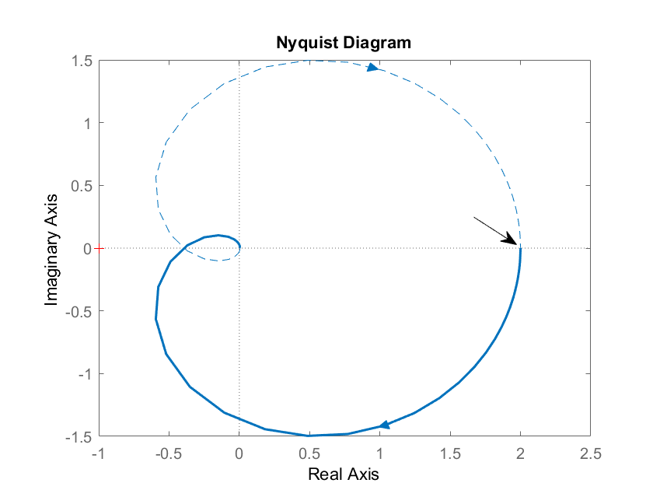
$$ω=0$$
$$φ(ω)$$
Crossover $ω$
AR($ω)$

Slide 6

Bode Stability Criterion
D(s)
Consider open-loop control system
1. Introduce sinusoidal input in setpoint (D(s)=0) and observe sinusoidal output
2. Fix gain such AR=1 and input frequency such that $φ$=-180
3. At same time, connect close the loop and set Y_{SP}(s)=0
Q: What happens if AR <1, 1 and >1?
Y_{SP}(s)
+
U(s)
+
Y(s)
G_{c}
G_{p}
-
+
G_{s}
Y_{s}(s)
Open-loop Response to Y_{SP}(s)

Slide 7
Bode Stability Criterion
A closed-loop system is unstable if the frequency of the response of the open-loop G_{OL} has an amplitude ratio greater than one at the critical frequency. Otherwise it is stable.
Strategy:
1. Solve for ω in
2. Calculate AR

Slide 8
Bode Stability Criterion
To check for stability:
1. Compute open-loop transfer function
2. Solve for ω in φ=-π
3. Evaluate AR at ω
4. If AR>1 then process is unstable
Find ultimate gain:
1. Compute open-loop transfer function without controller gain
2. Solve for ω in φ=-π
3. Evaluate AR at ω
4. Let

Slide 9
Bode Criterion
Consider the transfer function and controller
- Open-loop transfer function
- Amplitude ratio and phase shift
- At φ=-π, ω=1.4128, AR=6.746

Slide 10
Bode Stability
Phase Crossover frequency ($ω_{gc})$is the frequency at which phase lag is 180⁰.
Gain Crossover frequency ($ω_{pc}$) is the frequency at which AR = 1
Gain Margin (GM) is the amount of gain required for the AR to reach 1 at phase crossover frequency.
GM=1/AR_{C} , where AR_{C} is the Amplitude ratio at gain crossover frequency.
Phase Margin (PM) is the amount of phase difference required for phase lag to reach 180⁰ at gain crossover frequency. PM=180+$φ_{pc}$ where $φ_{pc}$ is phase lag at phase crossover frequency.

Slide 11
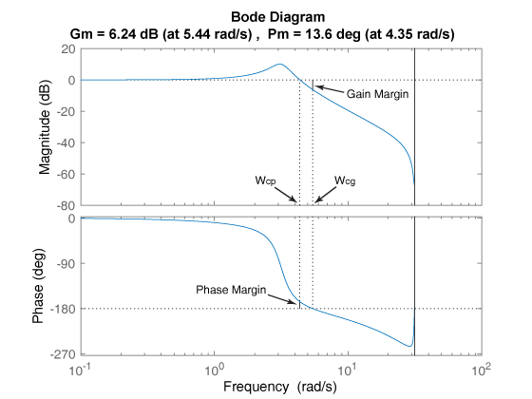
Gain Margin and Phase Margin
Wcg is the frequency where the gain margin is measured, which is a -180° phase crossing frequency.
Wcp is the frequency where the phase margin is measured, which is a 0-dB gain crossing frequency.
dB=20 log₁₀AR

Slide 12
Nyquist Stability Criterion
If N is the number of times that the Nyquist plot encircles the point (-1,0) in the complex plane in the clockwise direction, and P is the number of open-loop poles of G_{OL} that lie in the right-half plane, then Z=N+P is the number of unstable roots of the closed-loop characteristic equation.
Strategy
1. Substitute s=jω in G_{OL}(s)
2. Plot G_{OL}(jω) in the complex plane
3. Count encirclements of (-1,0) in the clockwise direction

Slide 13
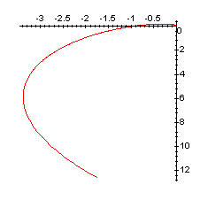
Nyquist Criterion
Consider the transfer function
and the P controller

Slide 14
PID Controller Tuning

Slide 15
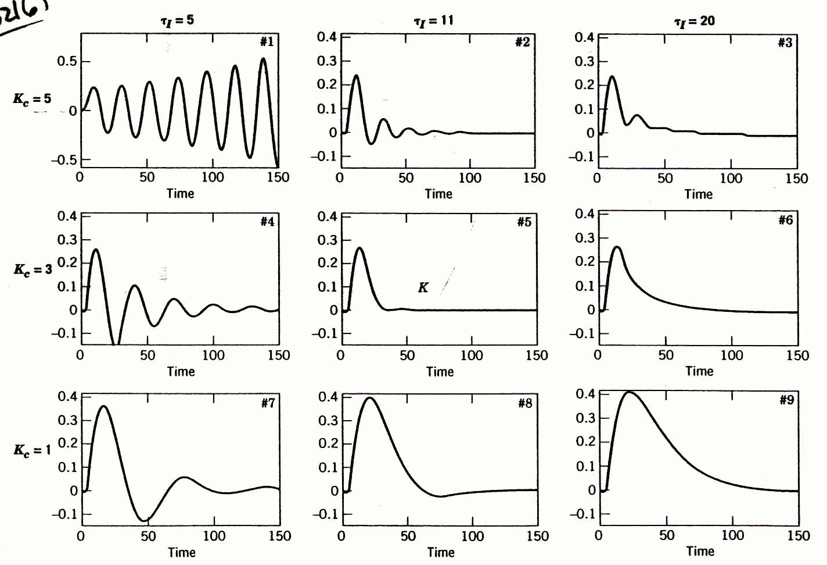
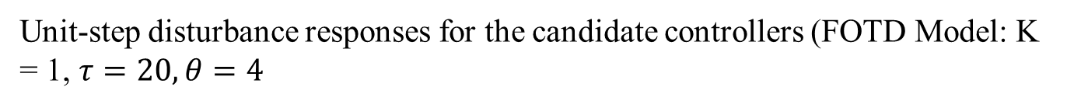
Controller Tuning: A Motivational Example
Unit-step disturbance responses for the candidate controllers (FOTD Model: K = 1, $τ=20, θ=4$

Slide 16
Performance Criteria For Closed-Loop Systems
The closed-loop system must be stable.
The effects of disturbances are minimized, providing good disturbance rejection.
Rapid, smooth responses to set-point changes are obtained, that is, good set-point tracking.
Steady-state error (offset) is eliminated.
Excessive control action is avoided.
The control system is robust, that is, insensitive to changes in process conditions and to inaccuracies in the process model.

Slide 17
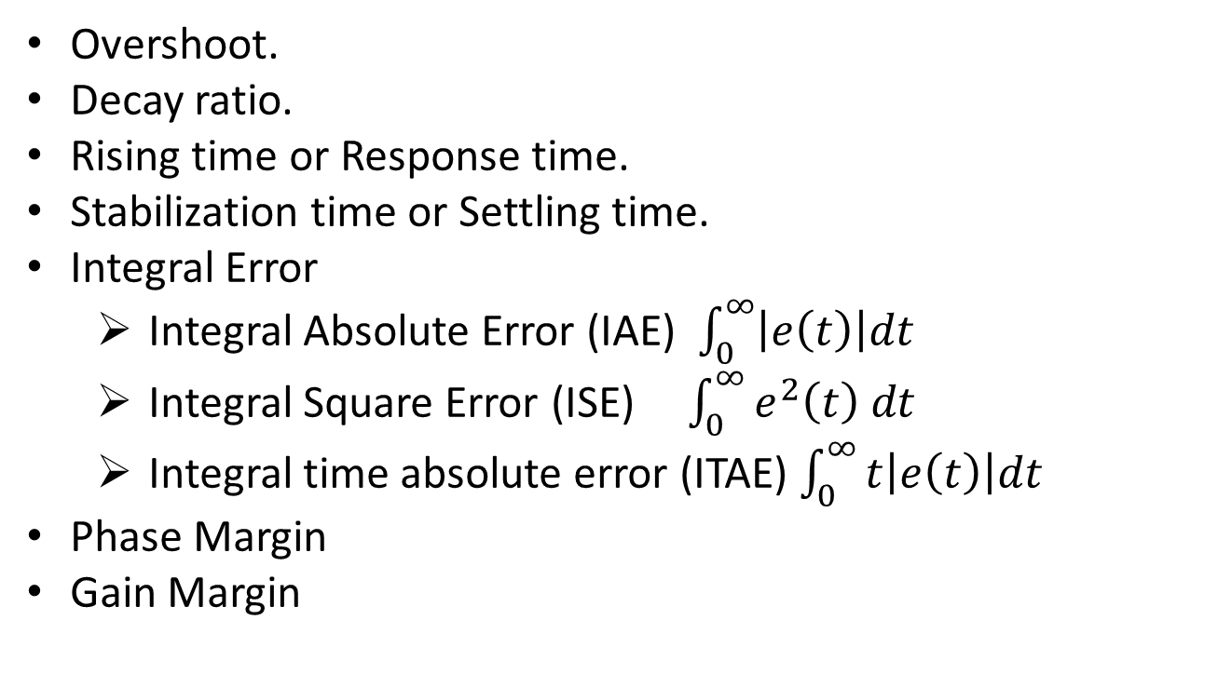
Measure of Control Performance
Overshoot.
Decay ratio.
Rising time or Response time.
Stabilization time or Settling time.
Integral Error
Integral Absolute Error (IAE) $\int_{0}^{∞}{\left|e\left(t\right)\right|dt}$
Integral Square Error (ISE) $\int_{0}^{∞}{e^{2}\left(t\right) dt}$
Integral time absolute error (ITAE) $\int_{0}^{∞}{t\left|e\left(t\right)\right|dt}$
Phase Margin
Gain Margin

Slide 18
PID controller settings can be determined by a number of alternative techniques:
Empirical Tuning correlations using FODT model
Step response FODT model
Continuous Cycling
Direct Synthesis (DS) method
Internal Model Control (IMC) method
Optimization method
Frequency response techniques
On-line tuning after the control system is installed.

Slide 19
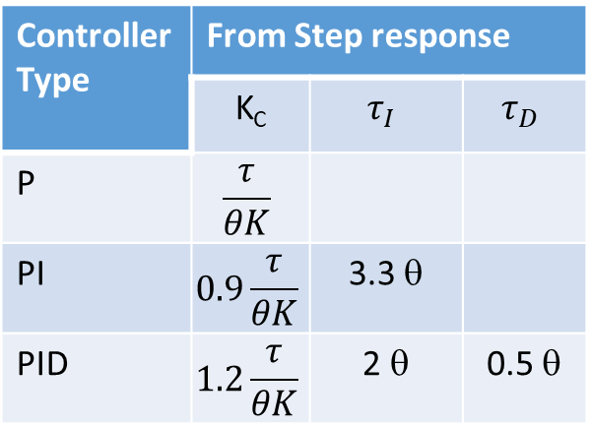
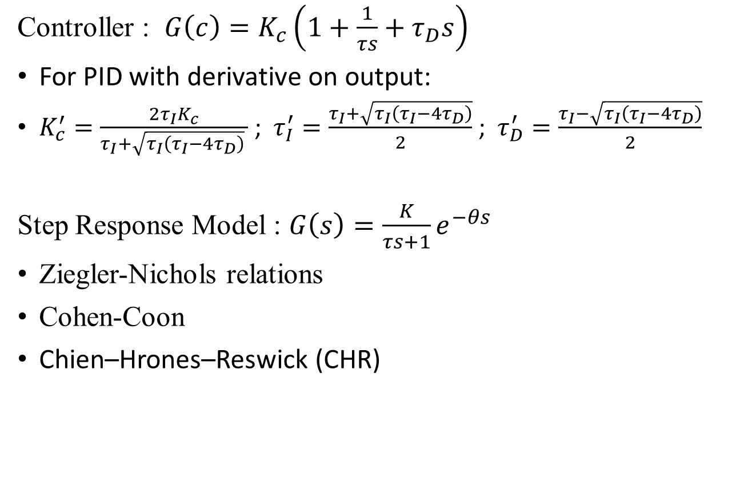
Empirical Tuning Correlations:
Controller : $G\left(c\right)=K_{c}\left(1+\frac{1}{τs}+τ_{D}s\right)$
For PID with derivative on output:
$K_{c}^{′}=\frac{2τ_{I}K_{c}}{τ_{I}+\sqrt{τ_{I}\left(τ_{I}−4τ_{D}\right)} }$ ; $τ_{I}^{′}=\frac{τ_{I}+\sqrt{τ_{I}\left(τ_{I}−4τ_{D}\right)}}{2}$ ; $τ_{D}^{′}=\frac{τ_{I}−\sqrt{τ_{I}\left(τ_{I}−4τ_{D}\right)}}{2}$
Step Response Model : $G\left(s\right)=\frac{K}{τs+1}e^{−θs}$
Ziegler-Nichols relations
Cohen-Coon
Chien–Hrones–Reswick (CHR)
Controller Type | From Step response
 | K_{C} | $$τ_{I}$$ | $$τ_{D}$$
P | $$\frac{τ}{θK}$$
PI | $$0.9\frac{τ}{θK}$$ | 3.3 θ
PID | $$1.2\frac{τ}{θK}$$ | 2 θ | 0.5 θ

Slide 20
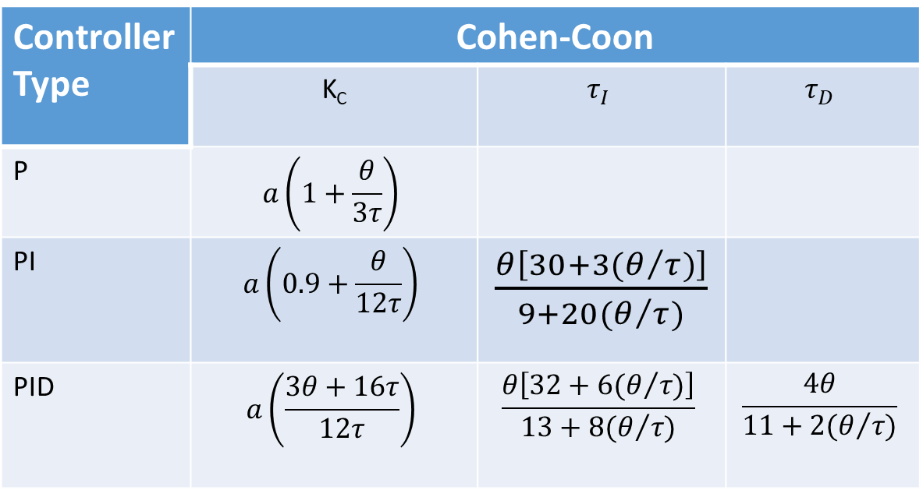
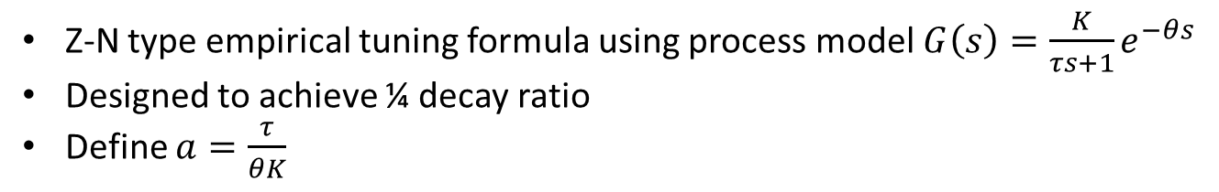
Cohen-Coon formula
Z-N type empirical tuning formula using process model $G\left(s\right)=\frac{K}{τs+1}e^{−θs}$
Designed to achieve ¼ decay ratio
Define $a=\frac{τ}{θK}$
Controller Type | Cohen-Coon
 | K_{C} | $$τ_{I}$$ | $$τ_{D}$$
P | $$a\left(1+\frac{θ}{3τ}\right)$$
PI | $$a\left(0.9+\frac{θ}{12τ}\right)$$ | $\frac{θ\left[30+3(θ/{τ)}\right]}{9+20(θ/{τ)}}$
PID | $$a\left(\frac{3θ+16τ}{12τ}\right)$$ | $$\frac{θ\left[32+6(θ/{τ)}\right]}{13+8(θ/{τ)}}$$ | $$\frac{4θ}{11+2(θ/{τ)}}$$

Slide 21
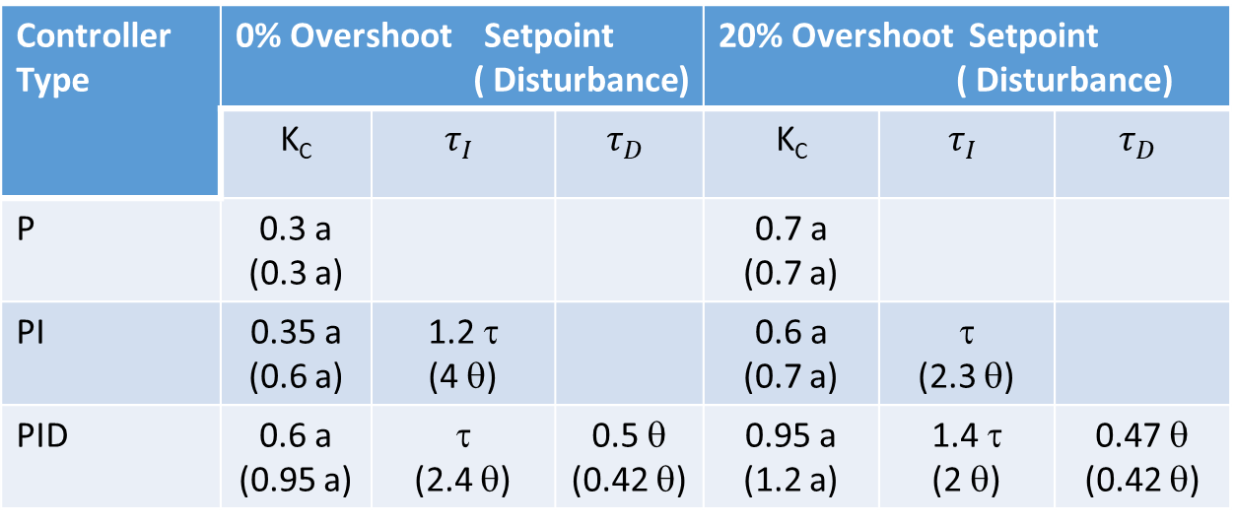
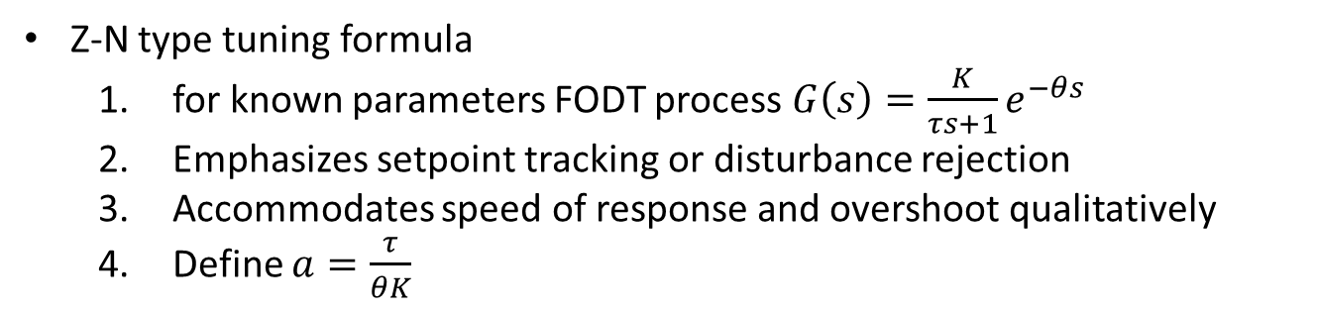
Chien–Hrones–Reswick (CHR) tuning formula
Z-N type tuning formula
for known parameters FODT process $G\left(s\right)=\frac{K}{τs+1}e^{−θs}$
Emphasizes setpoint tracking or disturbance rejection
Accommodates speed of response and overshoot qualitatively
Define $a=\frac{τ}{θK}$
Controller Type | 0% Overshoot Setpoint ( Disturbance) |  |  | 20% Overshoot Setpoint ( Disturbance)
 | K_{C} | $$τ_{I}$$ | $$τ_{D}$$ | K_{C} | $$τ_{I}$$ | $$τ_{D}$$
P | 0.3 a (0.3 a) |  |  | 0.7 a (0.7 a)
PI | 0.35 a (0.6 a) | 1.2 τ (4 θ) |  | 0.6 a (0.7 a) | τ (2.3 θ)
PID | 0.6 a (0.95 a) | τ (2.4 θ) | 0.5 θ (0.42 θ) | 0.95 a (1.2 a) | 1.4 τ (2 θ) | 0.47 θ (0.42 θ)

Slide 22
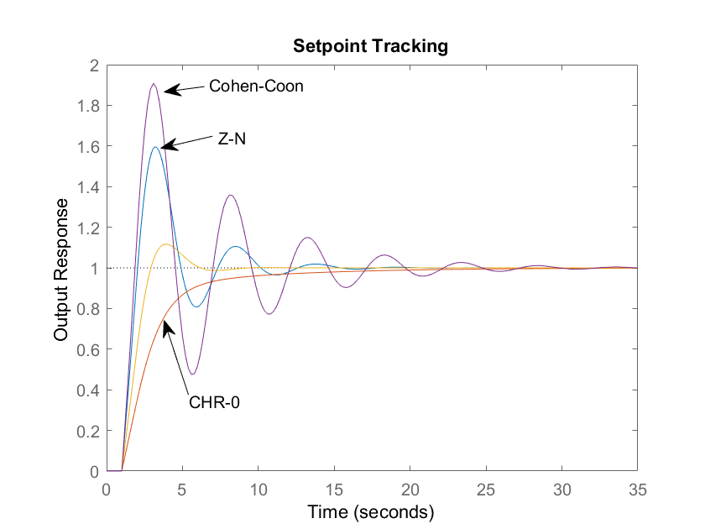
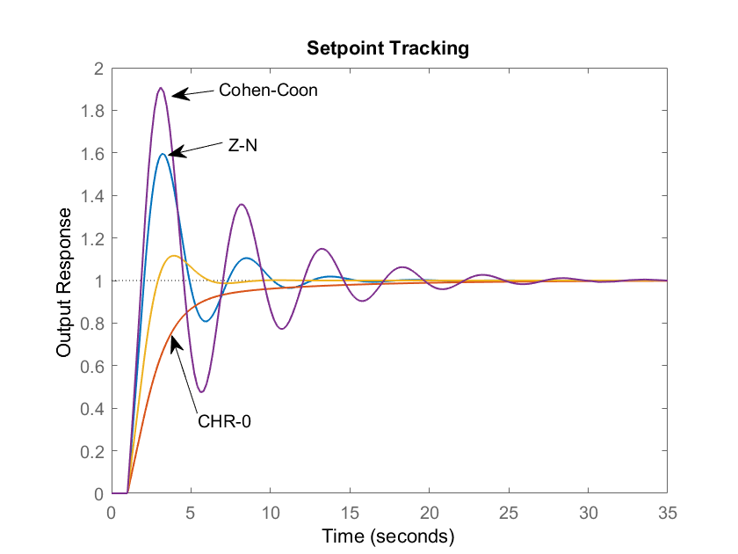

Slide 23
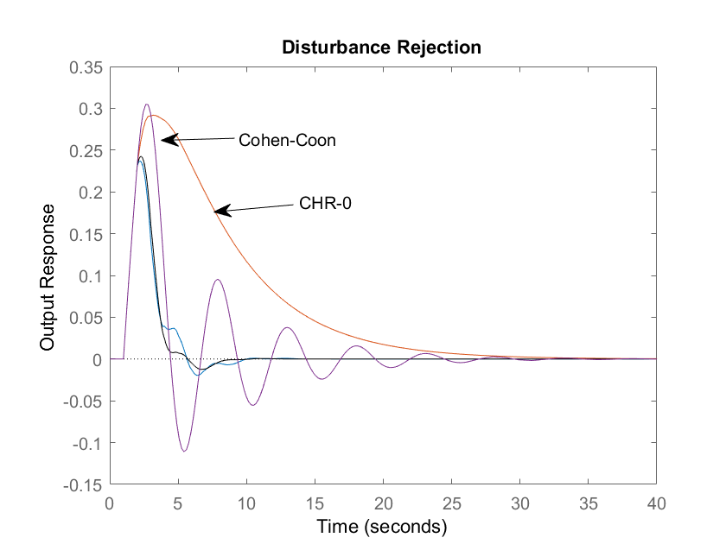
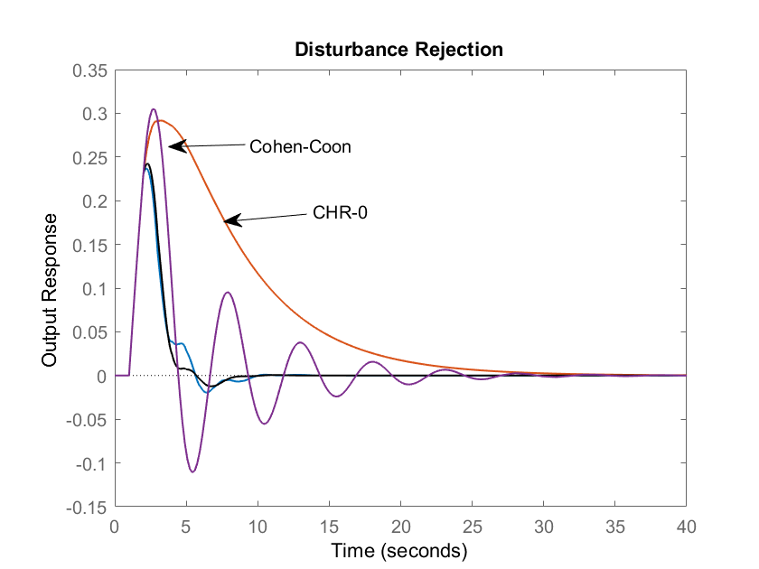

Slide 24
Continuous Cycling Method
Ziegler and Nichols (1942) introduced the continuous cycling method for controller tuning. It is based on the following trial-and-error procedure:
Step 1. After the process has reached steady state (at least approximately), eliminate the integral and derivative control action.
Step 2. Set K_{c} equal to a small value and place the controller in the automatic mode.
Step 3. Introduce a small set-point step change so that the controlled variable moves away from the set point. Gradually increase K_{c} in small increments until continuous cycling occurs.

Slide 25
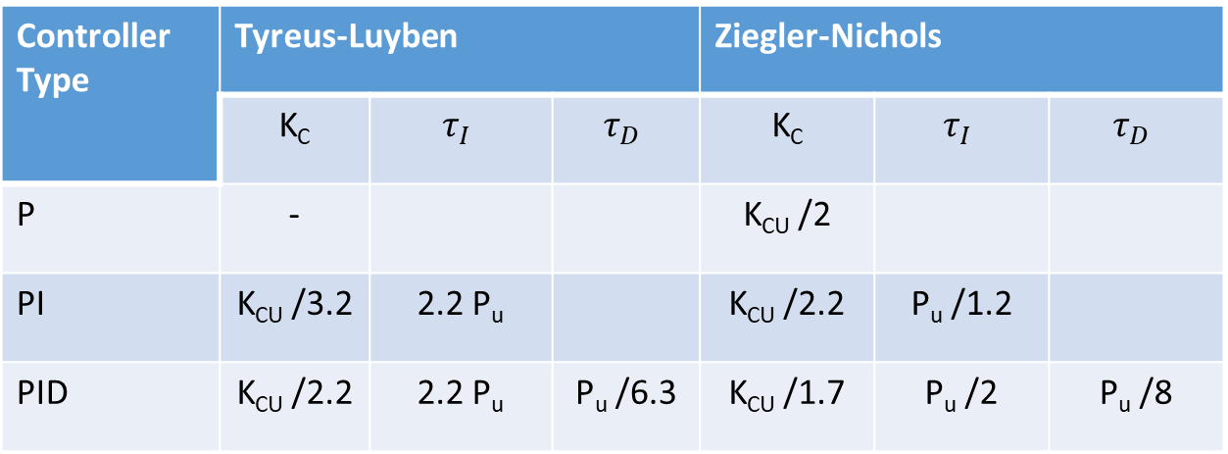
The term continuous cycling refers to a sustained oscillation with a constant amplitude. The numerical value of Kc that produces continuous cycling (for proportional-only control) is called the ultimate gain, K_{cu}. The period of the corresponding sustained oscillation is referred to as the ultimate period, P_{u}.
Step 4. Calculate the PID controller settings using the tuning relations in Table.
Controller Type | Tyreus-Luyben |  |  | Ziegler-Nichols
 | K_{C} | $$τ_{I}$$ | $$τ_{D}$$ | K_{C} | $$τ_{I}$$ | $$τ_{D}$$
P | - |  |  | K_{CU} /2
PI | K_{CU} /3.2 | 2.2 P_{u} |  | K_{CU} /2.2 | P_{u} /1.2
PID | K_{CU} /2.2 | 2.2 P_{u} | P_{u} /6.3 | K_{CU} /1.7 | P_{u} /2 | P_{u} /8

Slide 26
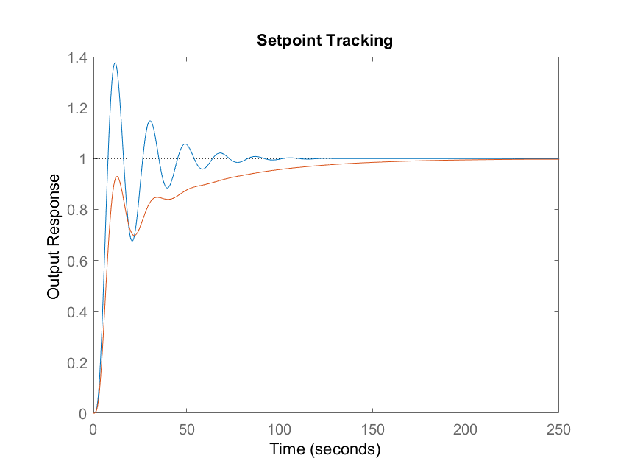

Slide 27
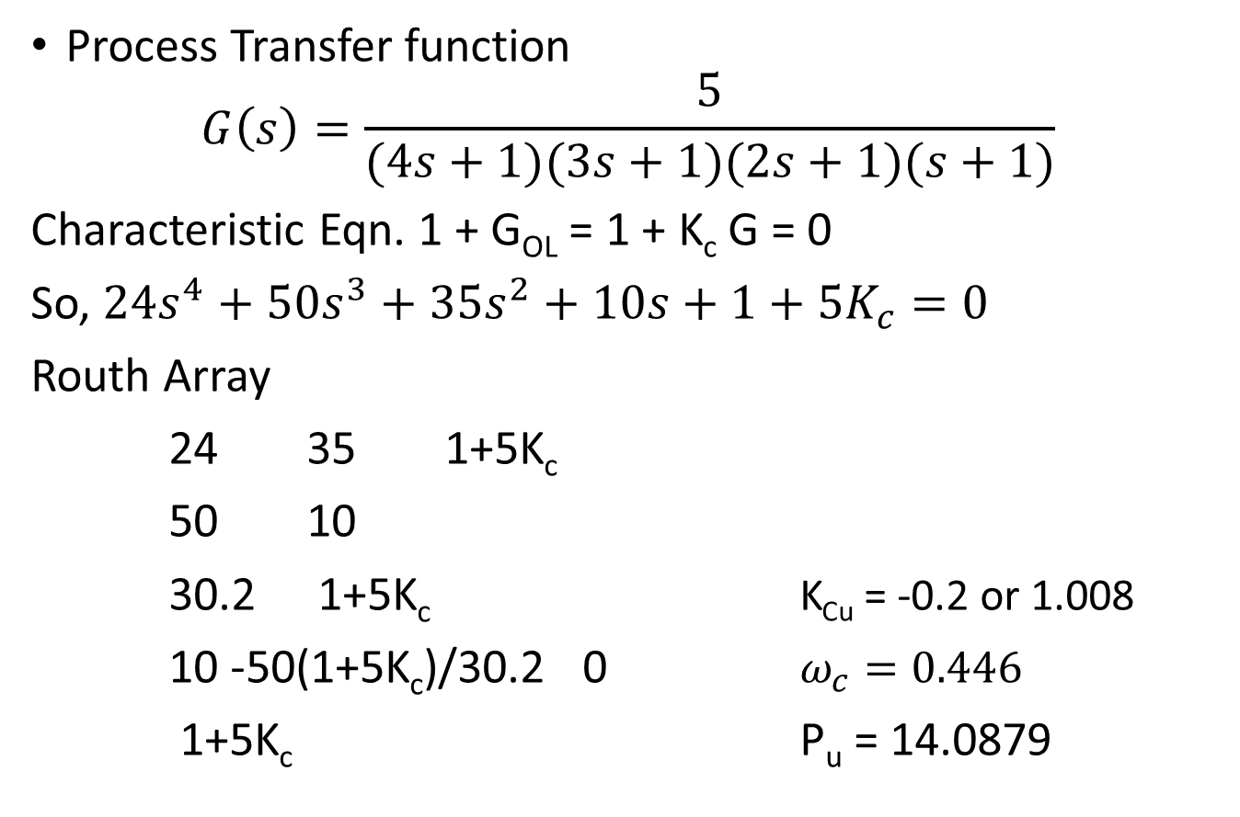
Example
Process Transfer function
$$G\left(s\right)=\frac{5}{(4s+1)(3s+1)(2s+1)(s+1)}$$
Characteristic Eqn. 1 + G_{OL} = 1 + K_{c} G = 0
So, $24s^{4}+50s^{3}+35s^{2}+10s+1+5K_{c}=0$
Routh Array
24 35 1+5K_{c}
50 10
30.2 1+5K_{c} K_{Cu} = -0.2 or 1.008
10 -50(1+5K_{c})/30.2 0 $ω_{c}=0.446$
1+5K_{c} P_{u} = 14.0879

Slide 28

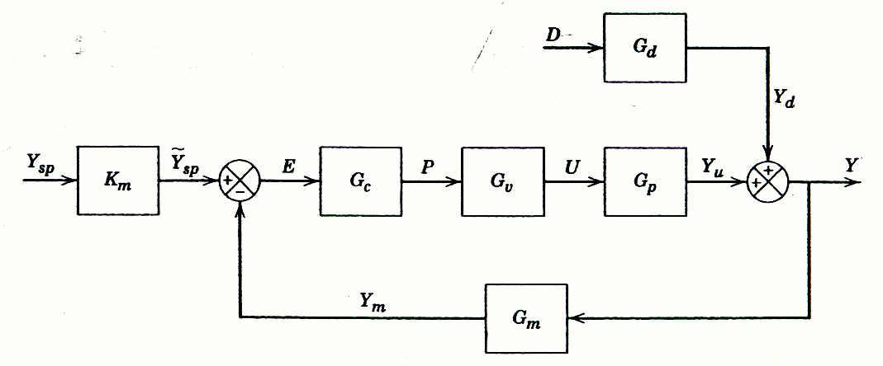
Direct Synthesis (DS) method
In the Direct Synthesis (DS) method, the controller design is based on a process model and a desired closed-loop transfer function.
Consider the block diagram of a feedback control system in Figure
The closed-loop transfer function for set-point changes is:
(1)

Slide 29
Direct Synthesis (DS) method
For simplicity, let and assume that G_{m} = K_{m}.
Then Eq. 1 reduces to:
Rearranging and solving for G_{c} gives an expression for the feedback controller:
Above equation cannot be used for controller design because the closed-loop transfer function Y/Y_{sp} is not known.

Slide 30
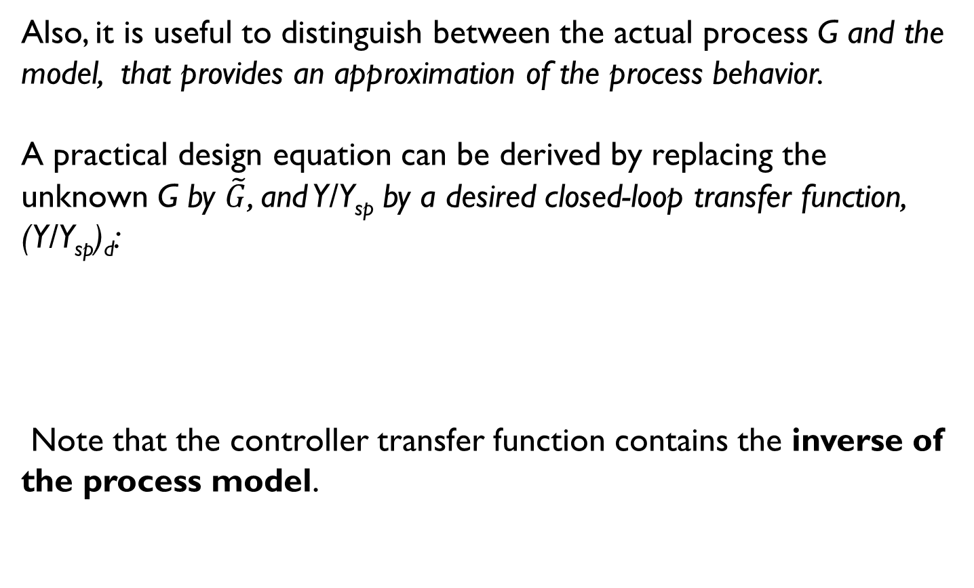
Direct Synthesis (DS) method [cont.]
Also, it is useful to distinguish between the actual process G and the model, that provides an approximation of the process behavior.
A practical design equation can be derived by replacing the unknown G by $\tilde{G}$, and Y/Y_{sp} by a desired closed-loop transfer function, (Y/Y_{sp})_{d}:
Note that the controller transfer function contains the inverse of the process model.

Slide 31
Direct Synthesis (DS) method [cont.]
For processes without time delays, the following first-order model is a reasonable choice,
Where τ_{c} is the desired closed loop time constant.
Because the steady-state gain is one, no offset occurs for set-point changes.

Slide 32
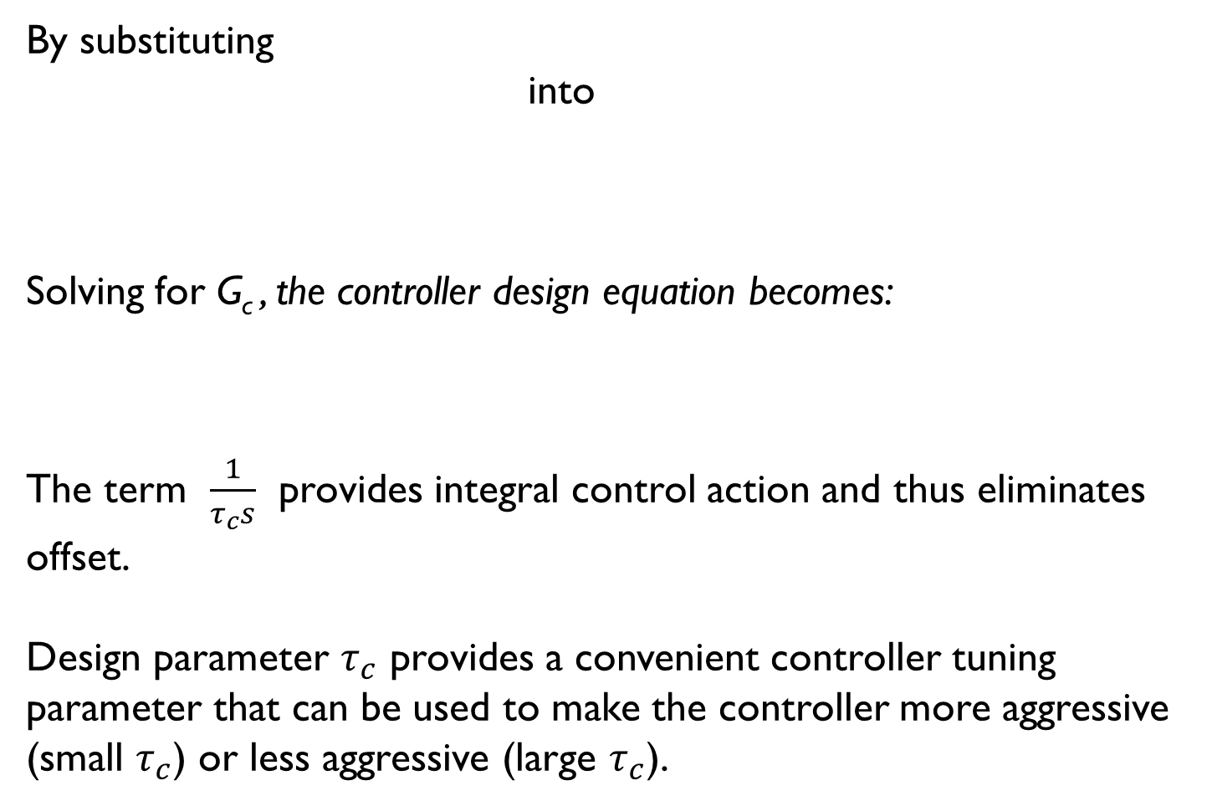
Direct Synthesis (DS) method [cont.]
By substituting
into
Solving for G_{c} , the controller design equation becomes:
The term $\frac{1}{τ_{c}s}$ provides integral control action and thus eliminates offset.
Design parameter $τ_{c}$ provides a convenient controller tuning parameter that can be used to make the controller more aggressive (small $τ_{c}$) or less aggressive (large $τ_{c}$).

Slide 33
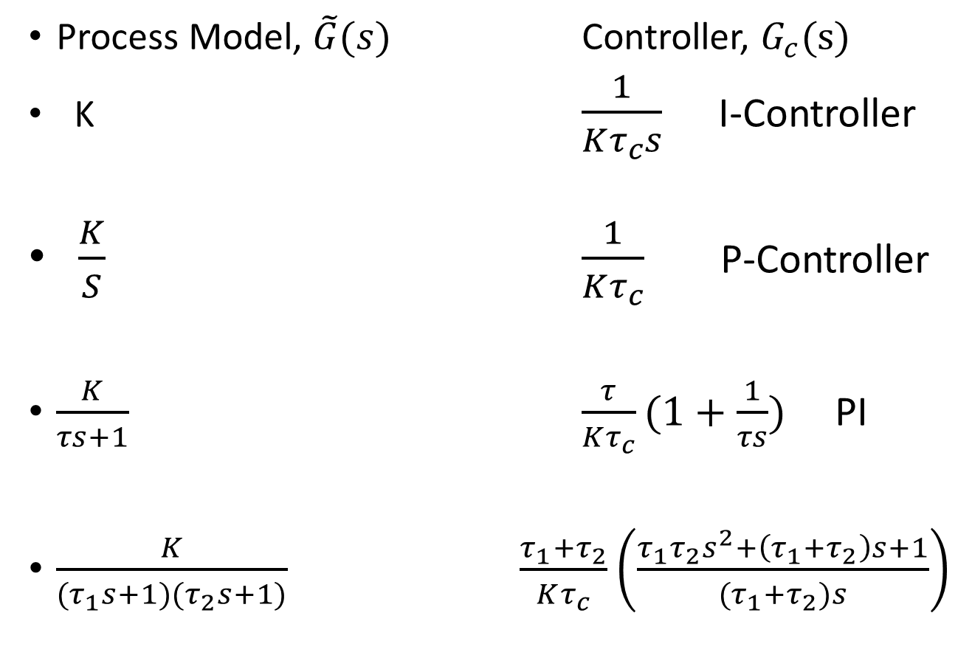
Direct Synthesis (DS) method [cont.]
Process Model, $\tilde{G}(s)$ Controller, $G_{c}(s)$
K $\frac{1}{Kτ_{c}s}$ I-Controller
$\frac{K}{S}$ $\frac{1}{Kτ_{c}}$ P-Controller
$\frac{K}{τs+1}$ $\frac{τ}{Kτ_{c}}(1+\frac{1}{τs})$ PI
$\frac{K}{{(τ}_{1}s+1)(τ_{2}s+1)}$ $\frac{τ_{1}+τ_{2}}{Kτ_{c}}\left(\frac{τ_{1}τ_{2}s^{2}+\left(τ_{1}+τ_{2}\right)s+1}{{(τ}_{1}+τ_{2})s}\right)$

Slide 34
Direct Synthesis (DS) method [cont.]
If the process transfer function contains a known time delay θ, a reasonable choice for the desired closed-loop transfer function is:
The time-delay term in above is essential because it is physically impossible for the controlled variable to respond to a set-point change at t = 0.
Combining reference trajectory with controller equation :

Slide 35
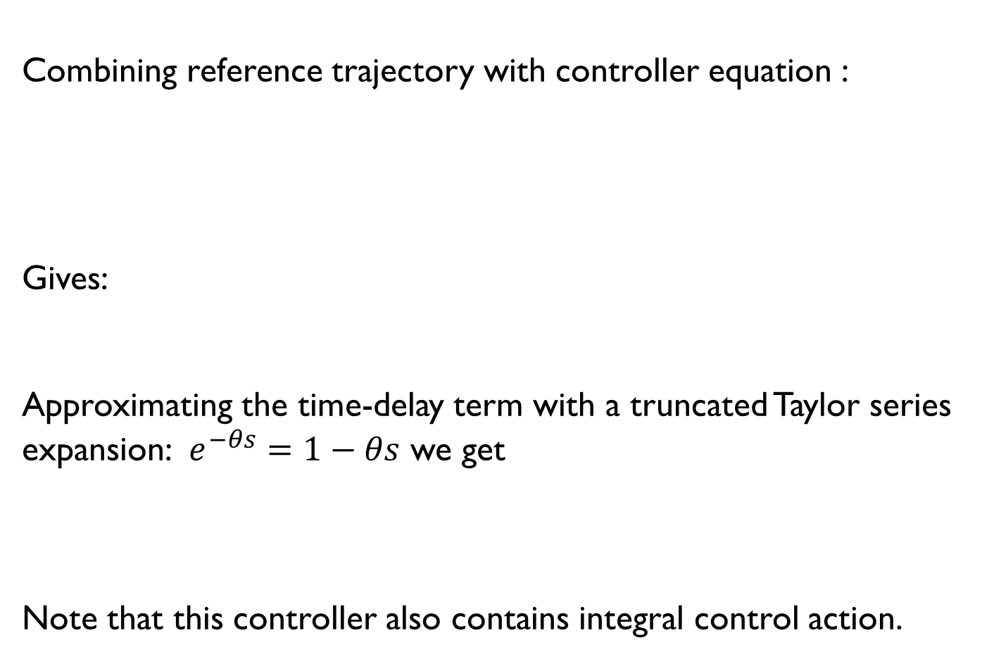
Direct Synthesis (DS) method [cont.]
Combining reference trajectory with controller equation :
Gives:
Approximating the time-delay term with a truncated Taylor series expansion: $e^{−θs}=1−θs$ we get
Note that this controller also contains integral control action.

Slide 36
Direct Synthesis (DS) method [cont.]
I. First Order with Dead Time (FOTD) Process
Consider the standard FOTD model,
Substituting FOTD model into Controller equation and rearranging gives a PI controller;
with the following controller settings:

Slide 37
Example 12.1
Use the DS design method to calculate PID controller settings for the process:
Consider three values of the desired closed-loop time constant: .
Evaluate the controllers for unit step changes in both the set point and the disturbance, assuming that G_{d} = G.
Repeat the evaluation for two cases:
a. The process model is perfect ( = G).
The model gain is incorrect, = 0.9, instead of the actual value, K = 2.

Slide 38
Direct Synthesis (DS) method [cont.]
2. Second-Order-plus-Time-Delay (SOTD) Model
Consider a second-order-plus-time-delay model,
Substitution into G_{c} eqn. and rearranging gives a PID controller;
with the following controller settings:

Slide 39
Example 12.1- Solution
Use the DS design method to calculate PID controller settings for the for two cases:
Comparing with standard PID controller;
Thus;
comparing

Slide 40
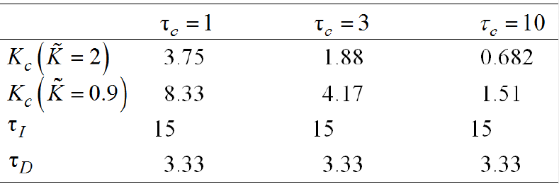
Example 12.1- Solution
The controller settings are as follows:
(a)For K =2
(b)For K =0.9
The values of K_{c} decrease as τ_{c} increases, but the values of τ_{I} and τ_{D} and do not change

Slide 41
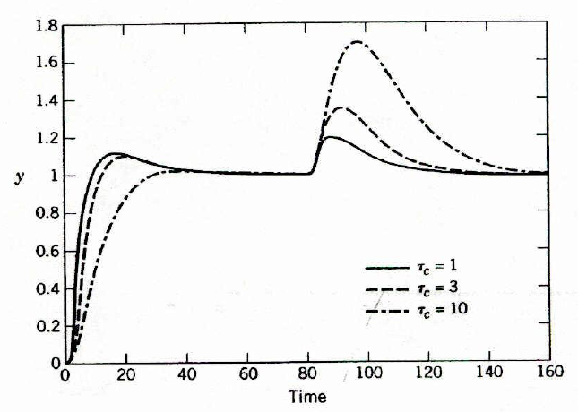
Example 12.1- Solution
Simulation results for (a)
( = G),
As τ_{c} increases, the responses become more sluggish
Increasing τ_{c}

Slide 42
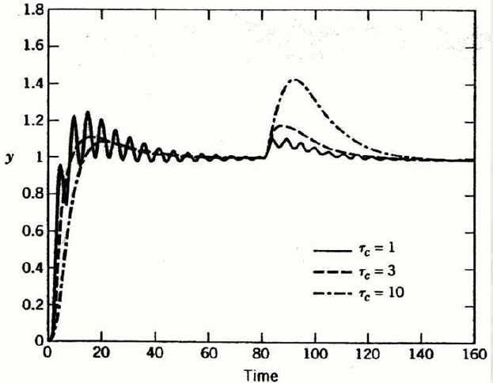
Example 12.1- Solution
Simulation results for (b)
( = 0.9).
Increasing τ_{c}
As τ_{c} increases, the responses become more sluggish

Slide 43
Example 12.1- Solution
Which one is better???WHY?

Slide 44
Thank you

Slide 45
Direct Synthesis Method
In the Direct Synthesis (DS) method, the controller design is based on a process model and a desired closed-loop transfer function.
The latter is usually specified for set-point changes, but responses to disturbances can also be utilized (Chen and Seborg, 2002).
Although these feedback controllers do not always have a PID structure, the DS method does produce PI or PID controllers for common process models.
As a starting point for the analysis, consider the block diagram of a feedback control system in Figure 12.2. The closed-loop transfer function for set-point changes was derived in Section 11.2:

Slide 46
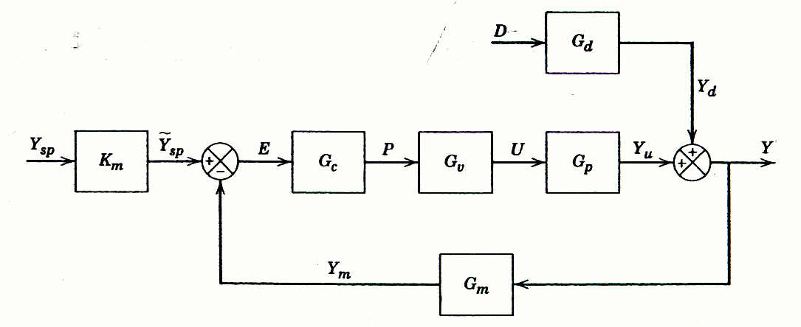
Fig. 12.2. Block diagram for a standard feedback control system.

Slide 47
For simplicity, let and assume that G_{m} = K_{m}. Then Eq. 12-1 reduces to
Rearranging and solving for G_{c} gives an expression for the feedback controller:
Equation 12-3a cannot be used for controller design because the closed-loop transfer function Y/Y_{sp} is not known a priori.
Also, it is useful to distinguish between the actual process G and the model, , that provides an approximation of the process behavior.
A practical design equation can be derived by replacing the unknown G by , and Y/Y_{sp} by a desired closed-loop transfer function, (Y/Y_{sp})_{d}:

Slide 48
The specification of (Y/Y_{sp})_{d} is the key design decision and will be considered later in this section.
Note that the controller transfer function in (12-3b) contains the inverse of the process model owing to the term.
This feature is a distinguishing characteristic of model-based control.
Desired Closed-Loop Transfer Function
For processes without time delays, the first-order model in Eq. 12-4 is a reasonable choice,

Slide 49
The model has a settling time of ~ 4 , as shown in Section 5. 2.
Because the steady-state gain is one, no offset occurs for set-point changes.
By substituting (12-4) into (12-3b) and solving for G_{c}, the controller design equation becomes:
The term provides integral control action and thus eliminates offset.
Design parameter provides a convenient controller tuning parameter that can be used to make the controller more aggressive (small ) or less aggressive (large ).

